Slide 1
GE 1211 The Contemporary World Synthesis on the 3 Prelim Readings
Diana Carmella T. labra, cpa ma
Economics department
Ateneo de davao university

Slide 2

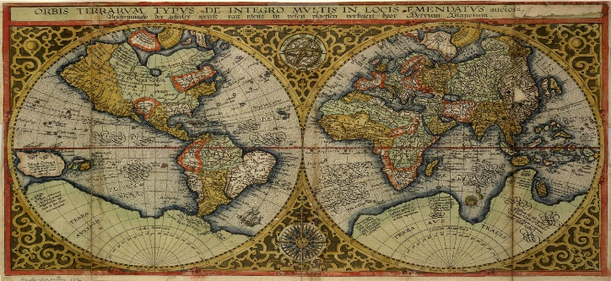

Prelim Topics
Foundations
Theories and Ideologies
Approaches to the Study

